Slide 1
CPBP 8306: Introduction to R
Stevenson Science & Engineering Library
Joshua Borycz

Slide 2
Pre-test assessment
https://forms.office.com/r/vDi4w5jEuN

Slide 3
Getting started

Slide 4
Download R & RStudio
https://posit.co/download/rstudio-desktop
What is R?
What is RStudio?
R is a language and environment for statistical computing and graphics
programming language
data handling and storage
operators for calculations on arrays
data analysis tools
Graphical tool
huge number of useful packages
RStudio is an Integrated Development Environment (IDE)
application for efficiently developing code
syntax highlighting
package management
visualization
debugging
testing
Notes:
we’ll demonstrate how to set up search alerts for queries in databases
Also run through a few searches in these
Mostly focusing on SciFinder

Slide 5
Data management for R projects
Create a GitHub repository (GitHub Desktop)
Create an R project (RStudio: File > New Project)
Create the following files and folders
README.md: text doc to describe and organize your code
main.R: main script you will use to run your code
raw_data: place the unchanged data into this folder
data: cleaned manipulated data can go here
scripts: scripts for different parts of your code
output: tables, figures, or files that your code produces
Name files using snake case (snake_case_is_good)
Use numbers at the beginning to order files (0_clean_data.R)
Use .gitignore to ignore certain folders and files
Notes:
we’ll demonstrate how to set up search alerts for queries in databases
Also run through a few searches in these
Mostly focusing on SciFinder

Slide 6
main.R
Load packages
install.packages(c("stats", "tidyverse"))
library(stats, tidyverse)
OR use pacman::p_load(stats, tidyverse)
Load data
name_of_object <- read_csv("path_to_data/folder/file.csv")
Run scripts
source("scripts/0_clean_data.R")
LEAVE DESCRIPTIVE COMMENTS!!!
Notes:
we’ll demonstrate how to set up search alerts for queries in databases
Also run through a few searches in these
Mostly focusing on SciFinder

Slide 7
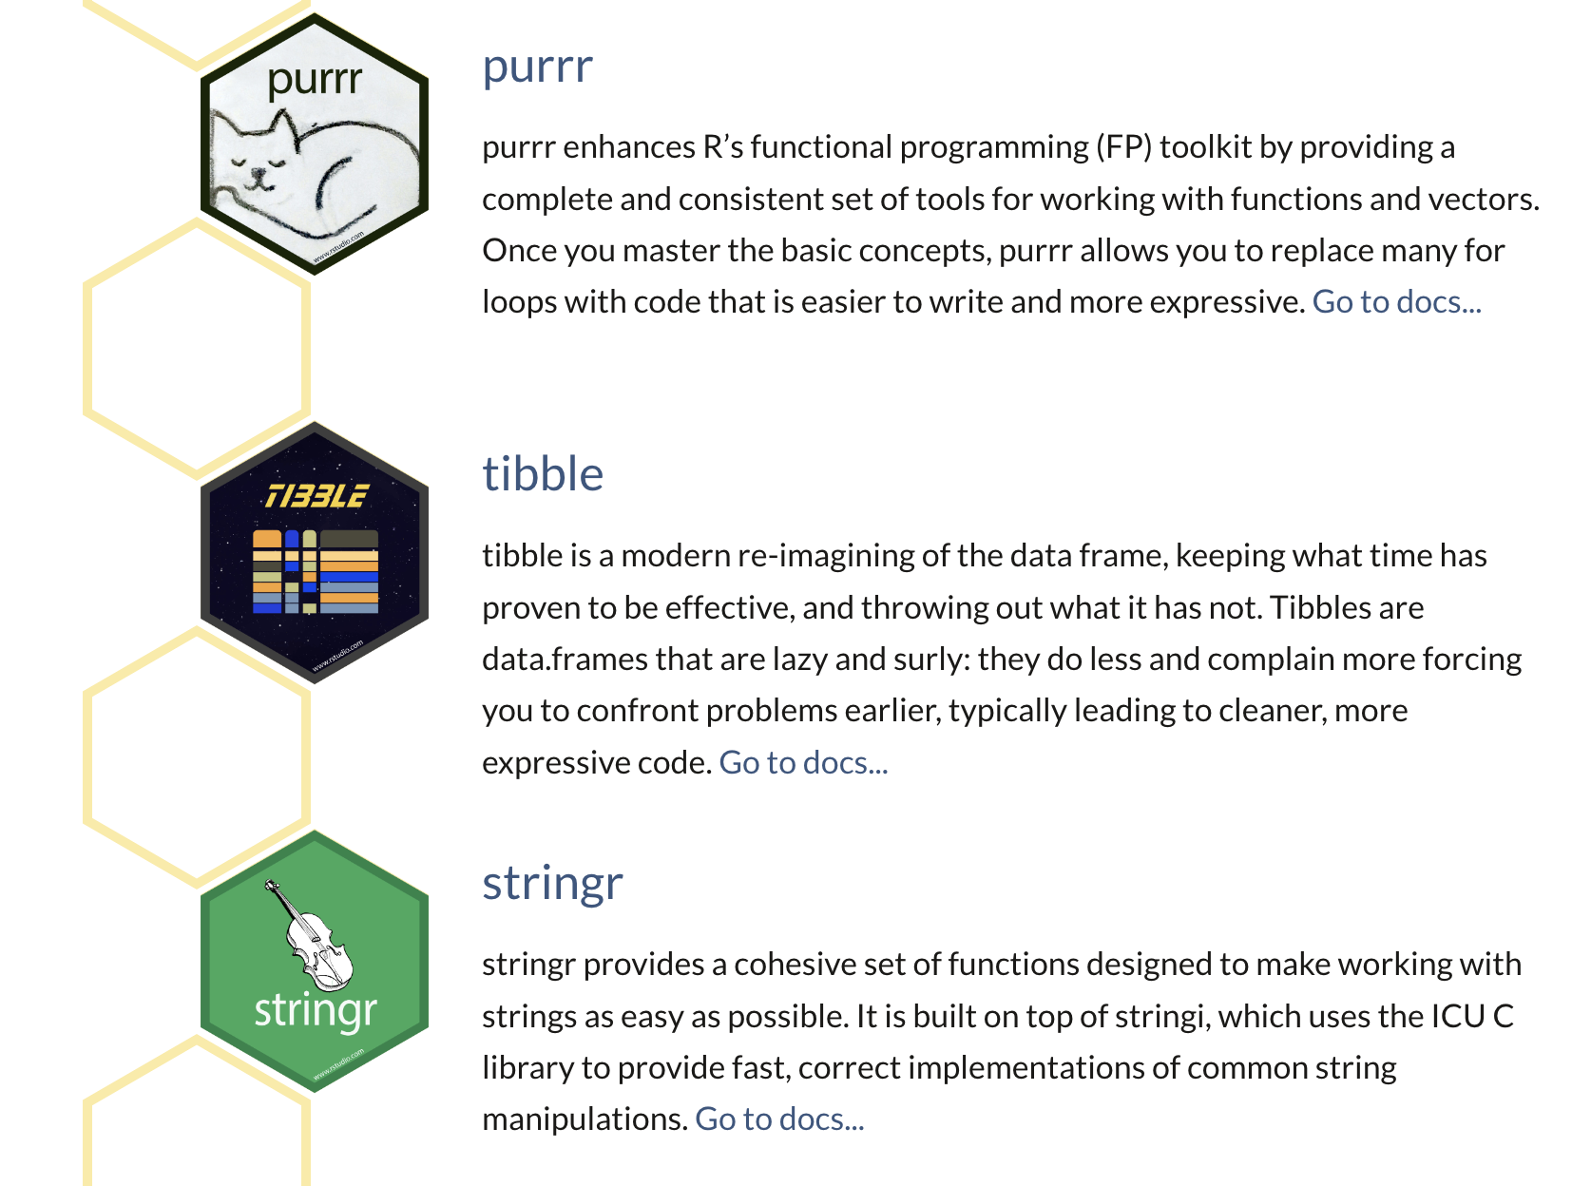
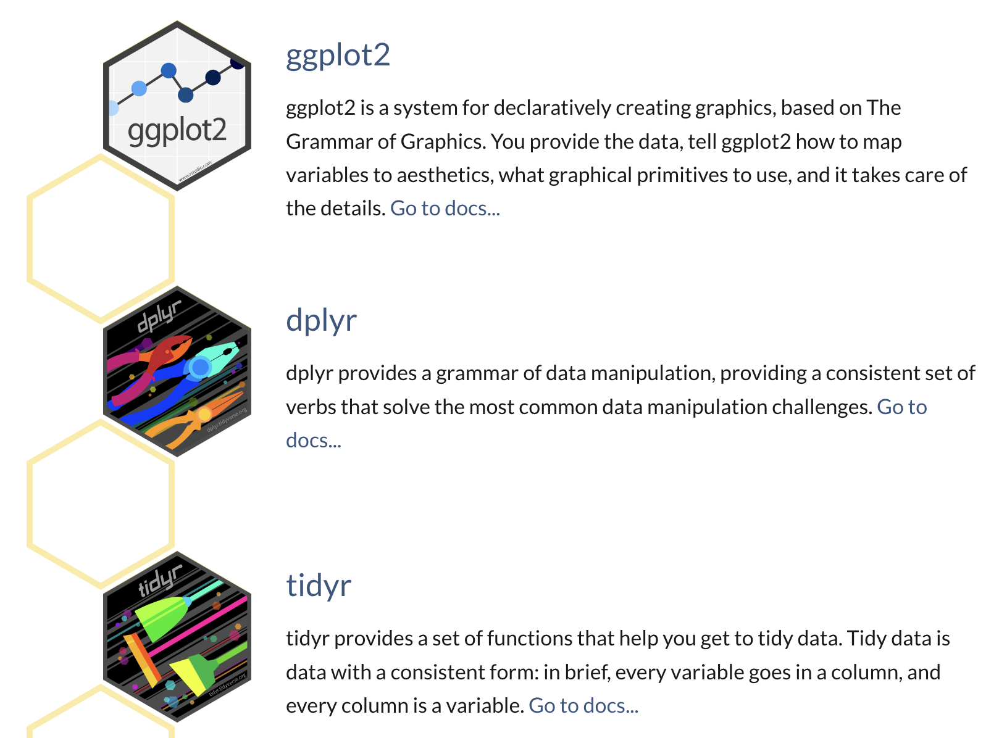
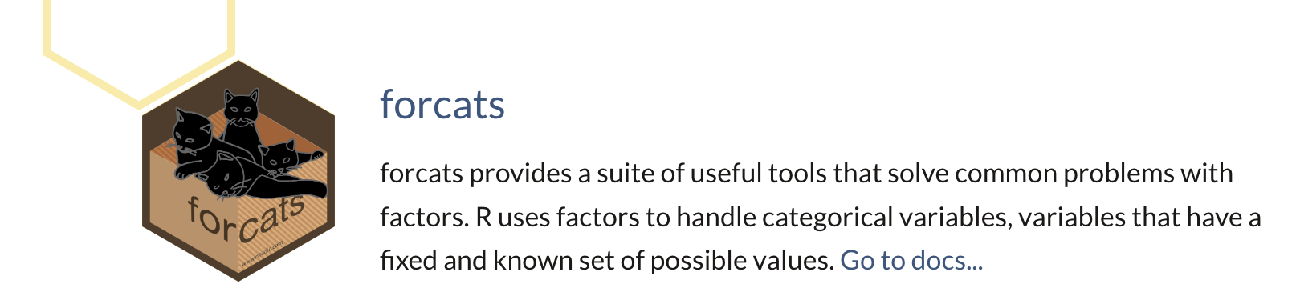
Tidyverse
https://www.tidyverse.org
Notes:
we’ll demonstrate how to set up search alerts for queries in databases
Also run through a few searches in these
Mostly focusing on SciFinder

Slide 8
Other packages
The Comprehensive R Archive Network
https://cran.r-project.org
Find any R package and run R code
https://rdrr.io
Try these
Biostatistics
biostat3
bioi
psych
Notes:
we’ll demonstrate how to set up search alerts for queries in databases
Also run through a few searches in these
Mostly focusing on SciFinder

Slide 9
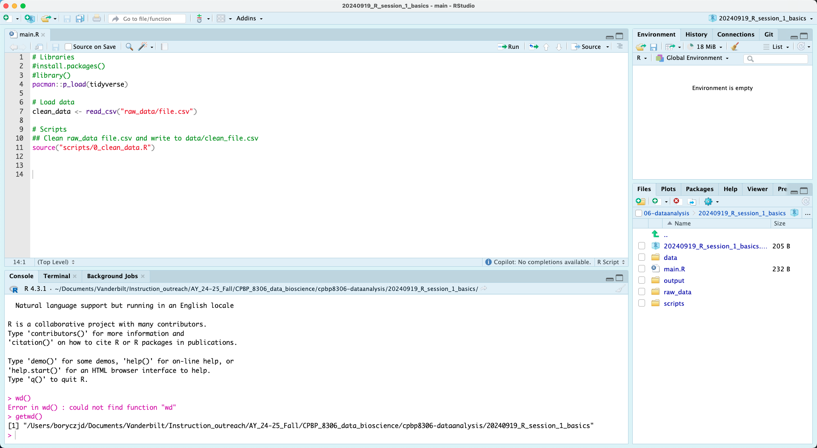
RStudio basics
Environment
Files
command + enter to submit line of code
Code & Terminal
Folders, viz, packages
Notes:
we’ll demonstrate how to set up search alerts for queries in databases
Also run through a few searches in these
Mostly focusing on SciFinder

Slide 10
Basic data structures in R
Aspect | Vector | List | Data frame | Tibble
Structure | 1D | 1D (recursive) | 2D (tabular) | 2D (tabular)
Homogeneity | Homogeneous (atomic) | Heterogeneous | Columns can differ; rows align | Columns can differ; rows align
Common types | logical, integer, double, character, etc. | Any R objects (incl. lists) | Columns: atomic or list | Columns: atomic or list
Length/shape | Length n | Length n (elements any size) | n rows and p columns | n rows and p columns
Row names | N/A | N/A | Supported | Not used (prefer a column)
Column names | N/A | Optional names per element | Made syntactic by default | Kept as given (can be non-syntactic)
Printing | Full vector | Shows list structure | Prints full rows by default | Truncated, type-aware preview
Subset with [ ] | Returns vector | Returns sub-list | df[, j] may drop to vector | tb[, j] always tibble (no drop)
[[ ]] access | Element by position/name | Element by position/name | Column as vector | Column as vector
$ access | N/A | Element by name | Allows partial matching | Exact matching only
Typical use | Simple sequences | Heterogeneous collections | Base R tabular data | Tidyverse-friendly tabular data
Example | c(1,2,3) | list(a=1:3, b="x") | data.frame(x=1:3,y=c("a","b","c")) | tibble(x=1:3, y=c("a","b","c"))

Slide 11
R code for today
Link: https://github.com/HeardLibrary/cpbp8306-dataanalysis/tree/main/Fall_2025/S02_20250828_r_basics_1
Folder: S02_20250828_r_basics_1
Notes:
we’ll demonstrate how to set up search alerts for queries in databases
Also run through a few searches in these
Mostly focusing on SciFinder

